Slide 1
Capstone Project - 5
Face Recognition with Drowsiness Alert
By: Sarvesh Kumar Yadav

Slide 2
Content:
Problem Statements
Introduction to Face Recognition
How does Face Recognition Works?
Extraction of Face Encodings
Matching of face encodings
How drowsiness can be detected
Facial landmark detector
Extraction of Eyes region of interest
Attendance System
Streamlit UI
Challenges
Conclusion

Slide 3
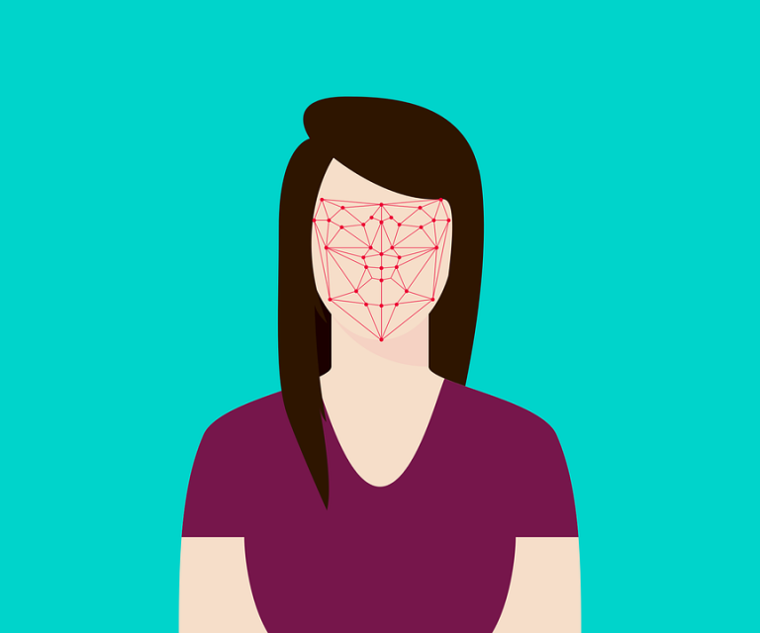
Problem Statement
The goal of the project was to come up with a face recognition system to mark attendance in an online classroom platform.
Along with the face recognition system, a drowsiness detection system needed to be developed to detect drowsiness on student's face
The project dealt with an integration of these two systems to develop an end to end solution.

Slide 4
Introduction to Face Recognition
To recognize a face a machine needs to know all the dimensions of the face, starting from the height/width of the face to width of other part of face like lips, nose etc. lips, nose, etc.
Different faces have different dimensions and similar faces have near to close dimensions.
A face can be considered as a representation of this dimensions to perform computational work.
The representation of faces with the help of different dimensional aspect is known as feature encoding.
Each image of face can be encoded into a feature vector representing the face.

Slide 5
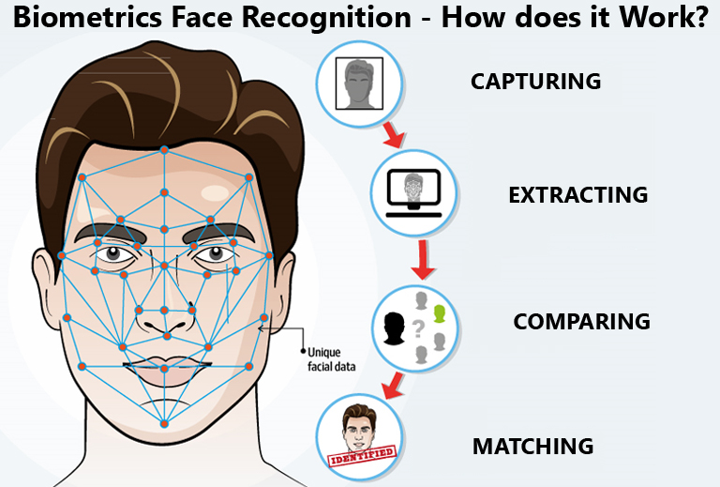
How does Face Recognition Works?

Slide 6
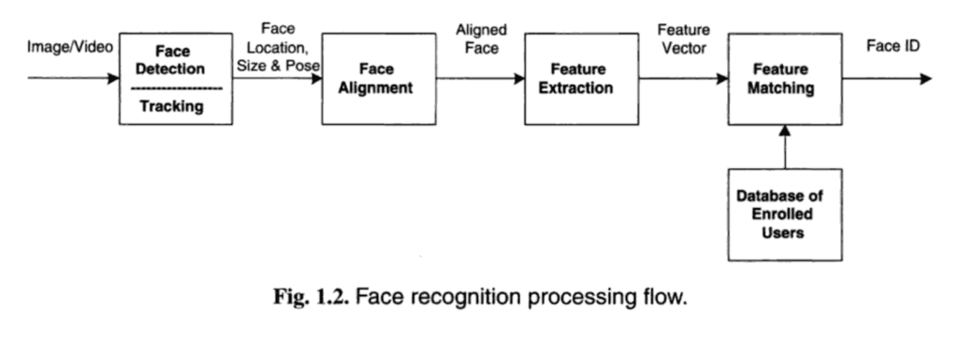

Slide 7
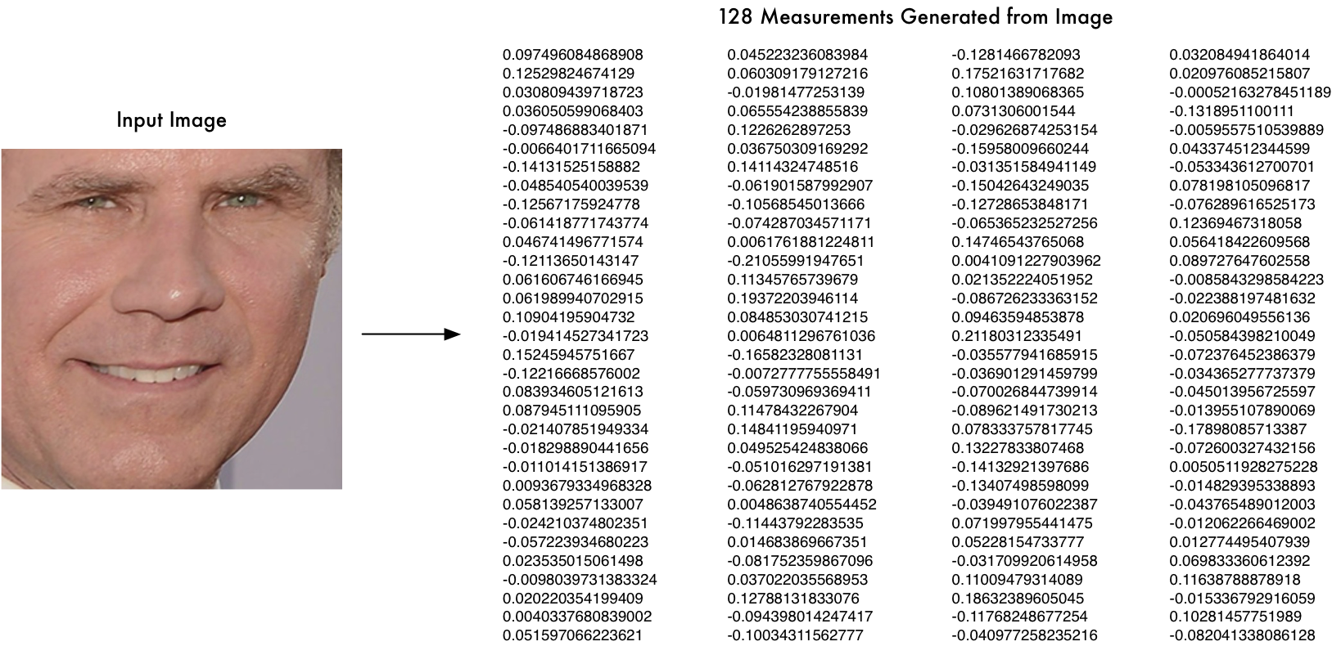
Extraction of Face Encodings
To extract the encodings from a face, a
Sophisticated face recognition library
is used known as face_recognition
The library is well equipped to extract
128 measurements from a single face
image.
Face encodings of known people are taken
along with their names and stored in a
Python dictionary.

Slide 8
Matching of Face Encodings:
The distance between two face encodings measures the level of similarity between two faces.
The face encodings of a new face is compared with all the known face encodings
The closest distance is compared with the threshold distance which is the maximum closest distance between two encodings to declare two faces to be a match.

Slide 9

How drowsiness can be detected?
Drowsiness can be detected by looking into the eyes of an individual.
The eyes tend to close down as we feel sleepy.
With the help of eye aspect ratio we can estimate the eye opening state

Slide 10
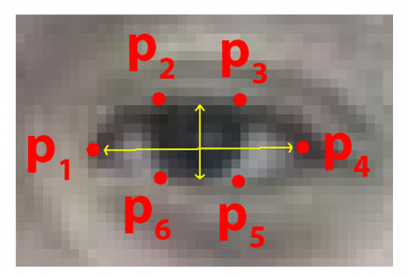
How drowsiness can be detected? (contd.)
P1, P2, P3, P4, P5 and P6 are the 2D landmark locations depicted in the above image

Slide 11
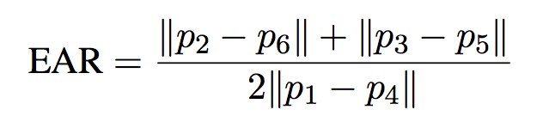
How drowsiness can be detected? (contd.)
The eye aspect ratio is mostly constant when an eye is open and is getting close to zero while closing an eye.
The eye aspect ratio between height and width of the eye is computed by equation shown above.

Slide 12
Facial landmark detector
Facial landmark are used to localize and represent salient region of the face such as eyes, nose, lips etc
Detecting facial landmarks is a subset of the shape prediction problem. Given an input image (and normally an ROI that specifies the object of interest), a shape predictor attempts to localize key points of interest along the shape.
In this project, the dlib's pretrained facial landmark detector is used. The pretrained detector is used to estimate the location of 68 coordinates that map to facial structure on the face

Slide 13
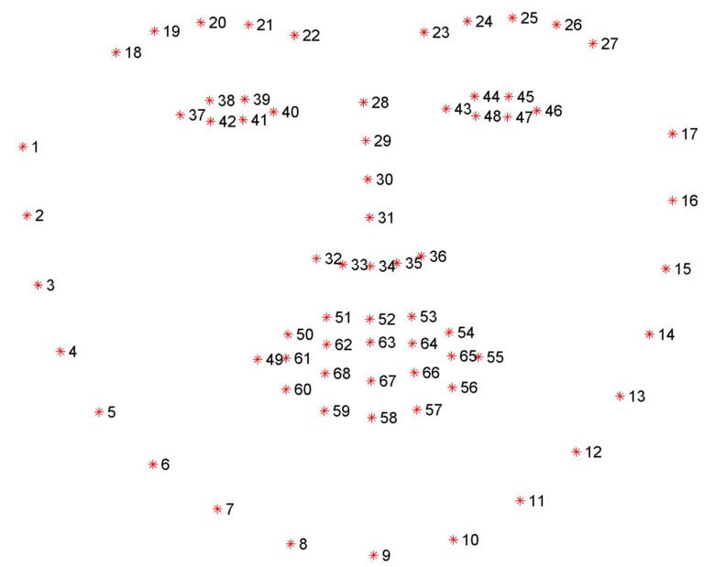
Facial landmark detector (contd.)
The indexes of the 68 coordinates can be visualized with the image shown above

Slide 14
Extraction of eyes region of interest
The eye aspect ratio can be calculated if the eye region of interest from the face is passed as an argument
The eye region is extracted using the face landmark predictor with 68 landmark indexes.
The eye aspect ratio is calculated as the average EAR obtained from both the eyes in a face.
Drowsiness is detected if the EAR value is less than the threshold EAR.

Slide 15
Attendance System
When a person logs in our system, the recognition system compare his face with all the known faces and if a match is found, the name of the person is noted.
The drowsiness system, detects drowsiness in the face and gives a status on drowsiness as an output.
In the end, the attendance of the student is registered with his name, date , time and drowsiness status.

Slide 16
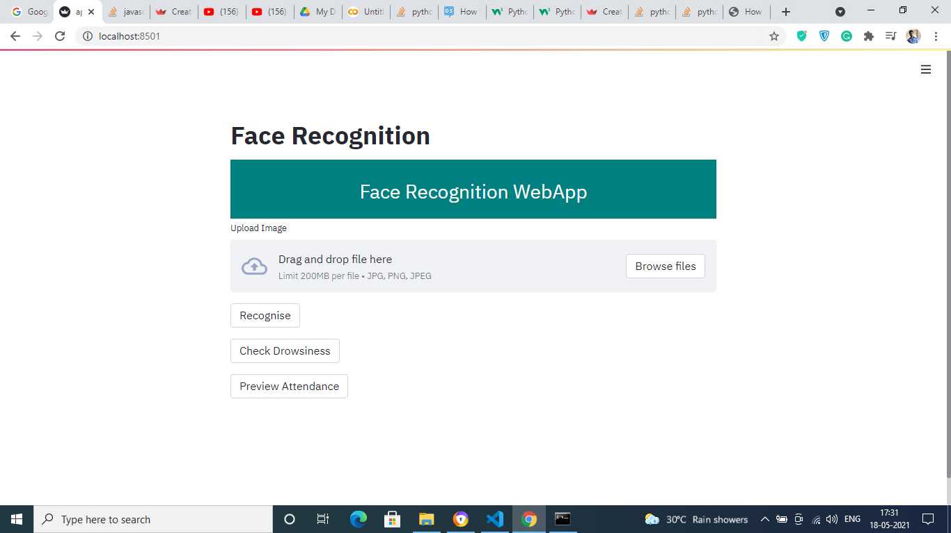
Streamlit UI

Slide 17
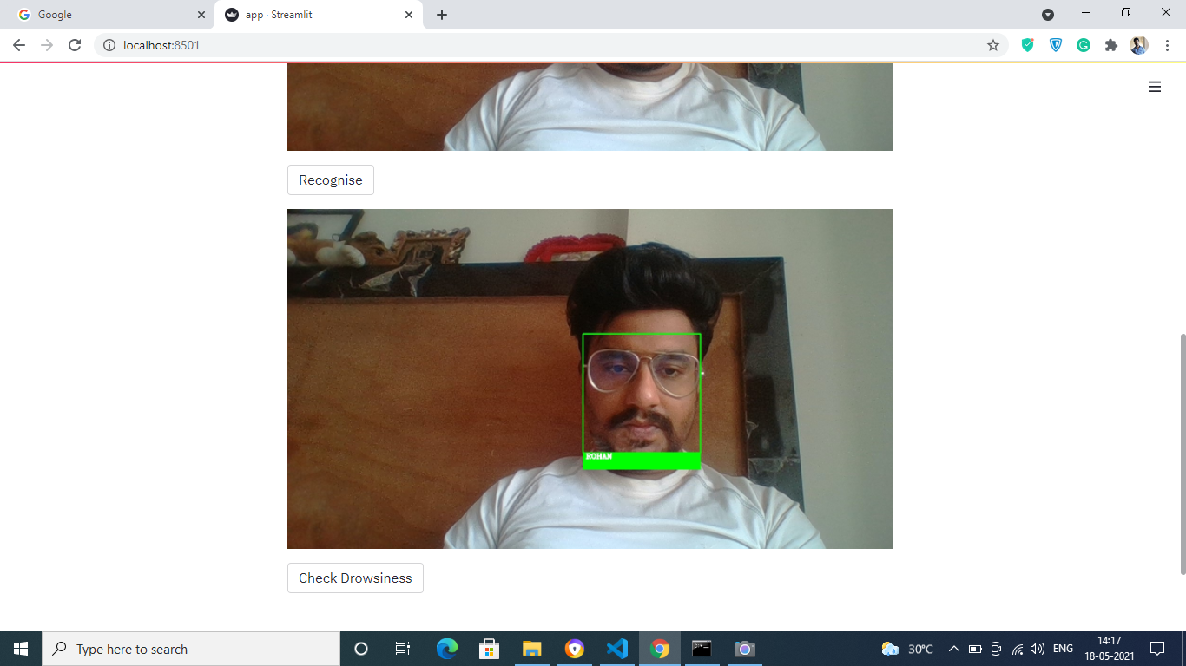
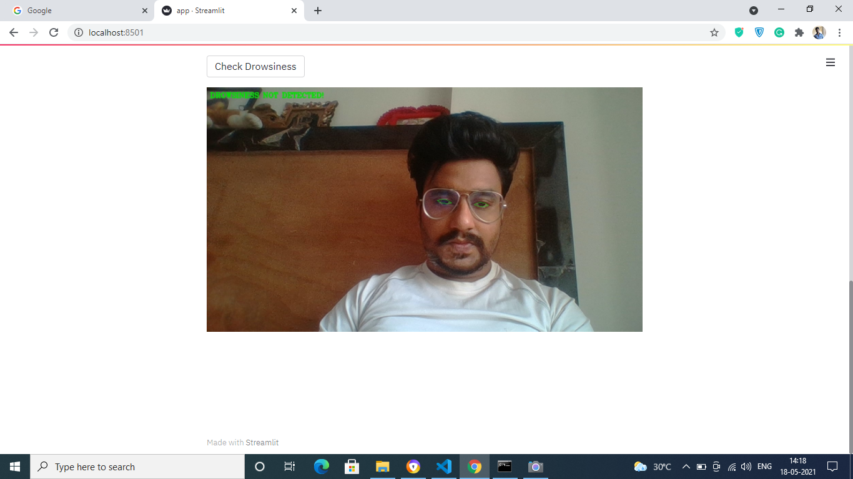
Streamlit UI (contd.)

Slide 18
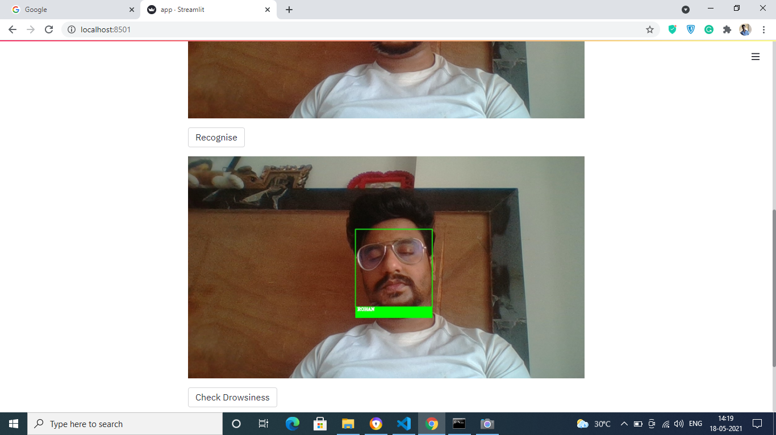
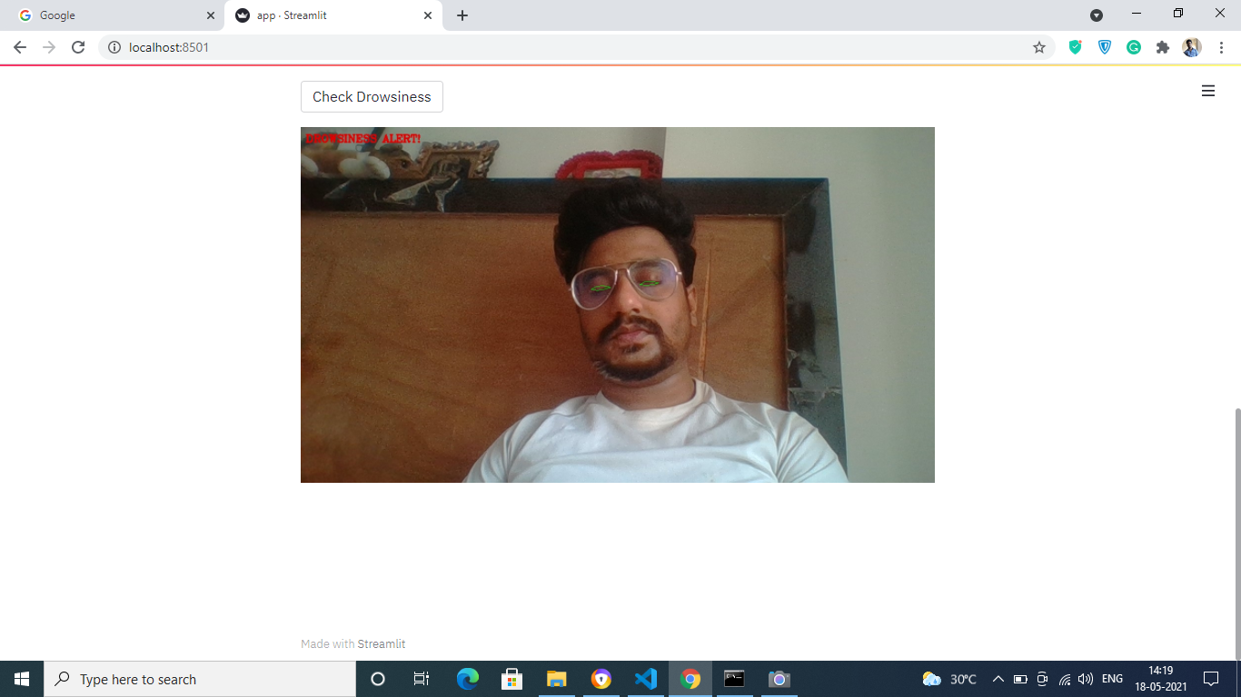
Streamlit UI (contd.)

Slide 19
Challenges
Just like any other computer vision project, the issue of illumination causes a significant challenge for automated face recognition and can have a significant impact on its result.
The pose of a face varies when the head movement and viewing angle of the person changes. It may result in faulty recognition or no recognition is the database only has the frontal view of the face.
The low resolution of images also possess a serious concern in identifying faces.

Slide 20
Future Work:
The UI for real time face recognition has not been built yet. The future goal would be to use javascript to built realtime face recognition system
The project also needs to be deployed on cloud computing servers.
Work needs to be done on the drowsiness detection part. Apart from eyes, the facial expression could also be used in detecting drowsiness.

Slide 21
Conclusion:
Face recognition technology has come a long way in the last twenty years.
The proposed approach for drowsiness detection system is very simple in terms of calculation.

Slide 22
Q & A

